Slide 1
English government traditions
http://youtu.be/B5AvQSESbUQ

Slide 2
What do you know about England today?

Slide 4
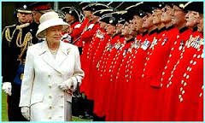
Now, these royals have very little power, but are considered “heads of state” meaning they go to dinners, travel out of the country, christen ships, etc.

Slide 5
It all started with the Magna Carta.

Slide 6
Limited Government
The English, over the last several centuries, put together a constitutional government.
This means that this is a limited government, it places limits on what the government can do. It is for these purposes, what it can and cannot do.
Began with King John and Magna Carta

Slide 7
Magna Carta protected the nobles
The Nobles got King John to sign the Magna Carta, giving the people certain liberties.
Taxation – king can’t tax any time he wants
Rule of law - the king has to obey the laws
Jury trial – the king isn’t the judge

Slide 8
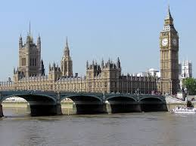
This leads to the British Parliament
1265
Any time the king needed money, he would have to call Parliament together and get their permission.

Slide 9
The Parliament Today
http://youtu.be/JJ6m71MmJnY

Slide 10
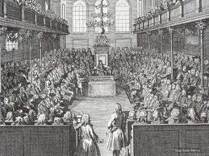
.
Charles I (19 November 1600 – 30 January 1649^{[a]}) was monarch of the three kingdoms of England, Scotland, and Ireland from 1625 until his execution in 1649.
Charles believed he had divine right. There was a civil war and Charles was executed.

Slide 11
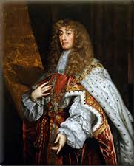
James II
For a while, there was no king. Then the king was restored and in things start to get really interesting when, in James II comes to the throne in 1685.
The English wanted to
get rid of him.

Slide 12
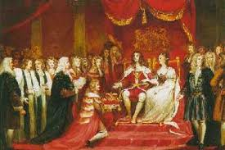
The Glorious Revolution
James was lucky, however, and instead of being executed, he was asked to leave.
No fighting
No deaths

Slide 13
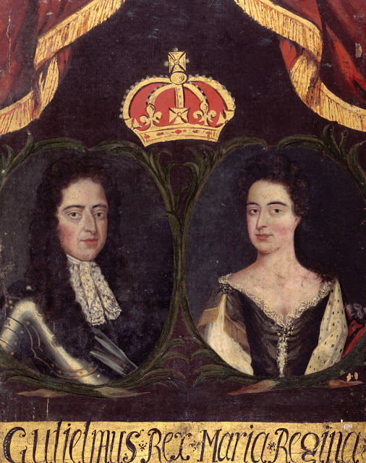
William and Mary
In comes in James’s daughter, Mary and her husband, William of Orange.
They signed the Bill of Rights

Slide 14
Rights in the English Bill of Rights
Parliamentary supremacy
free and frequent elections
the king can tax with the consent of Parliament
free speech, petition, arms for their defense
no mention of religious freedom

Slide 15
Also
Also, no cruel and unusual punishment
No standing armies – feared armies when we aren’t at war

Slide 16
Colonial Self Government
House of Burgesses – VA
General Court – MA
General Assembly – PA
Trial of John Peter Zenger
1760 – all colonies had some kind of legislature
50-75 % of white males could vote

Slide 17
Regulating Trade
Navigation Acts
Shipments had to go through England
In English ships
Sell only to England – tobacco and sugar

Slide 18
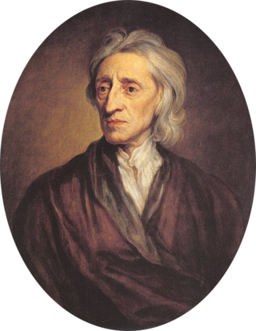
Who is the philosopher who helped inspire all of this?
John Locke – believed in natural rights
He influence the English Bill of Rights and the Declaration of Independence

Slide 19
Natural Rights
Everyone has those rights –
Government by consent-
They can make changes to the government or get rid of it –
The colonists brought these traditions with them.
Colonial self-government

Slide 20
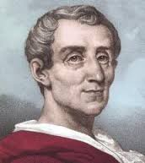
Baron de Montesquieu
We should divide power in the government into branches.
Legislative
Executive
Judicial
Why?

