Slide 1
DRUGS AND OUR SOCIETY
HEALTH

Slide 2
What is a Drug? How does it enter the body?
Drug- Chemical that causes changes in the mind and/or body.
They are introduced into the body by:
1.oral- through the mouth
2. injected- into the muscle, right
beneath the skin, into the vein
3. Inhaled- through the lungs via the nose
and/or mouth
4. Absorption- through the skin

Slide 3
Why do we have drugs in our society?
Purpose of Drugs in our society- To treat and/or prevent illness
2 categories of Drugs-
1. Legal- Drugs considered useful enough
to be available for sale and are designed to
treat medical problems
3 drugs that are legal and have no medical value---
caffeine, alcohol and nicotine…WHY?
Synthetic Drug- Man made drug

Slide 4
Legal Drugs
Prescription Drug-A drug that fights illness and disease that can be obtained only by written orders.
WHY?
Potency- The strength of a drug
Prescription will tell you:
Dosage- Amount needed in which the drug will produce an effect
Frequency
Special instructions
Drug interaction- Taking more than one drug at a time
Drug Misuse
Prescription drug abuse- Growing in US do to pain killers and mood
suppressant drugs.

Slide 5
Legal Drugs
Tolerance- Body becomes accustomed to the drug so the user must take more to get the same effect.
Physical Dependency- The user’s body needs the drug in order to avoid discomfort.
Mental Dependency- The drug is always on the user’s mind and has an overwhelming need to take it.
Withdrawal- Symptoms that appear once the use of the drug is stopped

Slide 6
Legal Drugs
Over the counter drug- (OTC) A drug that can be purchased without a prescription in stores
All Drugs produce effects!
Short term effects- Changes that occur after taking a drug and wear off as time goes by.
Long term effects- Changes that result after long use of a drug.
Side effects- Immediate unwanted changes

Slide 7
ILLEGAL DRUGS
What makes a drug illegal??
2.Illegal drug- Drugs forbidden by law for both sale or use/possession.
Drug abuse- Taking a drug for other than medical purposes.
Psychoactive Drugs
Depressant drugs- Drugs that slow down the CNS.
Stimulant drugs- Drugs that speed up the CNS.
Hallucinogen drugs- Drugs that cause users to see, hear or feel things that don’t exist.
Hallucinations- To see, hear or feel things that don’t exist.

Slide 8
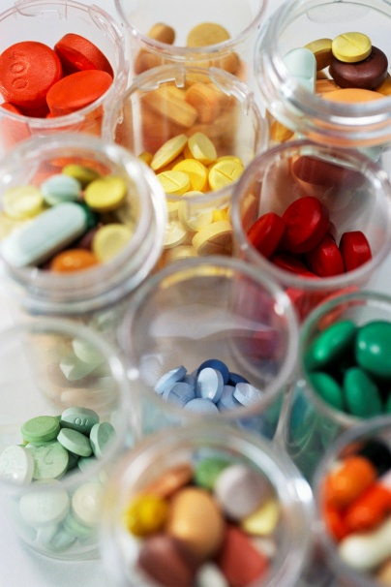
WHY DO PEOPLE DO DRUGS
Peer pressure
Lack of self esteem/ self concept
Personal or family problems…escape
Forget reality
No goals in life
Stress reducer
Thrill seeker
There is no one single cause and some times the reasons overlap.
Anyone can become a victim of Chemical Dependency.

