Slide 1
Warm UP/Agenda
GET YOUR BOOKS!
Take a study guide and vocabulary sheet.
CRCT Practice Book p. 19-21 (1-9).
PowerPoint: History Of Life On Earth
Brain Pop: Evolution

Slide 2
The History of Life on Earth
Many Types of Evidence Support Evolution.
McDougall/Littell

Slide 3
Many Types of Evidence Support Evolution.
1.B. Darwin did not publish his book explaining his theory until 1859.
A theory is a widely accepted statement, based on scientific evidence, that helps explain a group of facts.
Darwin's theory of evolution is widely accepted because it is supported by fossil evidence, biological evidence, and genetic evidence.

Slide 4
Many Types of Evidence Support Evolution
Evidence from fossils supports evolution.
An ancestor is an early form of an organism from which later forms descend.
According to the theory of evolution, different species should have common ancestors.
Fossil evidence supports this idea.
For example, modern plants and modern algae share characteristics with fossil algae that point to a common ancestor.

Slide 5
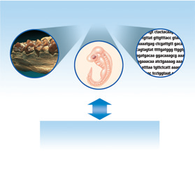

Slide 6
Many Types of Evidence Support Evolution
Both help scientists understand the relationships among organisms that exist today.
Biological evidence supports evolution.
Biological evidence includes the structure of living things and how living things develop into adults.

Slide 7
Many types of evidence support evolution.
Vestigial organs are physical structures that were fully developed and functional in an earlier group of organisms but are reduced and unused in later species.
These vestigial organs indicate that the organism had an ancestor that needed the trait, and can show how the modern organism and the ancestor are related.

Slide 8
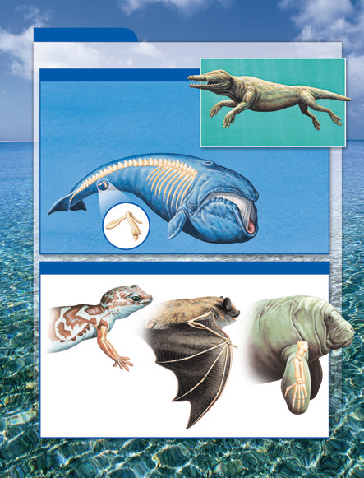

Slide 9
Many Types of Evidence Support Evolution.
Similar structures with different functions indicate that organisms shared a common ancestor.
The process of natural selection caused variations in form and use.
Organisms living in different environments were under different environmental pressures.
  For example, the illustrations show that geckos, bats, and manatees have similar bones in their forelimb.
  A shorter bone leads from the shoulder to a joint. From the joint, the longer bone leads to a wrist.
  Because the three organisms live in very different environments, the similar structures have evolved in very different ways.

Slide 10
Evolution Clues
    http://evolution.berkeley.edu/evosite/evo101/IIC1Homologies2.shtml
    http://evolution.berkeley.edu/evolibrary/article/similarity_ms_01

Slide 11
Many Types of Evidence Support Evolution.
Early life stages of some species do resemble each other.
Similarities in development of different species that are unlike as adults indicate a common ancestor.
  For example, a chicken, a rabbit, and a salamander are three very different animals.
  However, their embryos look very similar.
  As the embryos develop, they become more different.
  This evidence indicates that many animals must share a common ancestor whose embryo started developing in a similar way.

Slide 12
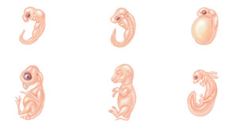



The study of embryos shows that animals that appear to be very different as adults are similar during early development.

Slide 13
Genetic Evidence Supports the Theory of Evolution.
DNA contains the genetic material found in all cells.
It contains a code that a cell uses to function properly.
The code is a pattern of four chemical units called bases, represented by the letters A, T, C, and G.

Slide 14
Genetic Evidence Supports the Theory of Evolution.
A small bit of nucleic acid found in the nuclei of all living cells.
Has huge effects on living organisms.
Carries information that cells of organisms use to produce traits.

Slide 15
Trends in Evolution
http://evolution.berkeley.edu/evosite/evo101/VIIDTrends.shtml

