Slide 1
The History of Life On Earth
Species change over time.
McDougall/Littell

Slide 2
Species change over time.
Evolution is the process by which species change over time.
Evolution occurs due to changes in the genetic material of an organism.
These changes are passed from one generation to the next when the organism reproduces.

Slide 3
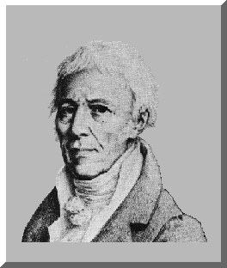
Species change over time
In the early 1800s, Jean-Baptiste de Lamarck proposed a theory of evolution.
He suggested that organisms develop traits during their lives and then pass them on to offspring.
For example, a giraffe stretches its neck to get high leaves, and then passes that longer neck to the next generation.
But Lamarck could not find evidence to support his theory.

Slide 4
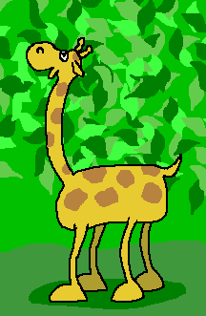
Species change over time
Giraffes will grow longer necks as they stretch for the top leaves.
As their necks get longer, this trait is passed onto their offspring.

Slide 5
Species change over time.
Charles Darwin was a naturalist who traveled to the Galapagos Islands in the late 1830s. Darwin's theory of evolution developed from observing different species of tortoises and finches on the Galapagos Islands.
For example, he found some finches with beaks useful for cracking seeds and others with beaks useful for capturing insects.
Darwin wondered whether the birds had evolved differently because they were in different environments.
http://www.classzone.com/books/ml_science_share/vis_sim/lotm05_pg7_finch/lotm05_pg7_finch.html

Slide 6
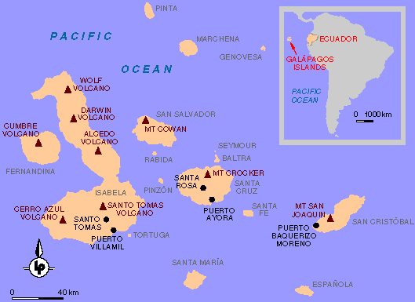

Slide 7
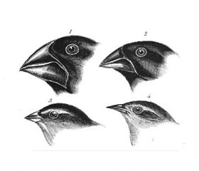

Slide 8
A group of organisms may evolve due to artificial selection or natural selection.
Artificial selection is the process that breeders use to produce animals with desirable traits.
A breeder will select individuals with desired traits from a group, then allow only those individuals to mate.
In the next generation, the breeder will again select the individuals with desired traits and mate them to produce the next generation.
Ex: Terriers

Slide 9
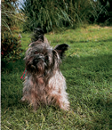
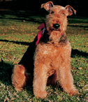
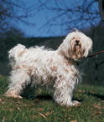

Slide 10
A group of organisms may evolve due to artificial selection or natural selection
Natural selection is the hypothesis Darwin developed based on his observations from his voyage and from his hobby of breeding pigeons.
Darwin proposed that members of a species that are best suited to their environment survive and reproduce at a higher rate than other members of the species.
This process is called natural selection.

Slide 11
The process of natural selection depends on a few key principles.
Overproduction is the idea that most organisms produce more offspring than can possibly survive.
For example, a female salmon lays thousands of eggs, but only several dozen will survive to adulthood, and even fewer will reproduce.

Slide 12
The process of natural selection depends on a few key principles.
Variation is the natural differences in traits among the members of a species.
Some might have slightly larger fins, others different patterns of spots.
Mutations are changes in genetic material that cause a variation.
Variations, due either to mutation or the random combination of genes from parents, are passed from one generation to the next.

Slide 13
The process of natural selection depends on a few key principles.
An adaptation is any inherited trait that gives an organism an advantage in its particular environment.
An adaptation is a variation that makes an individual better able to survive than others.
For example, a slight change in the shape of a fin might make a fish swim faster and avoid predators.

Slide 14
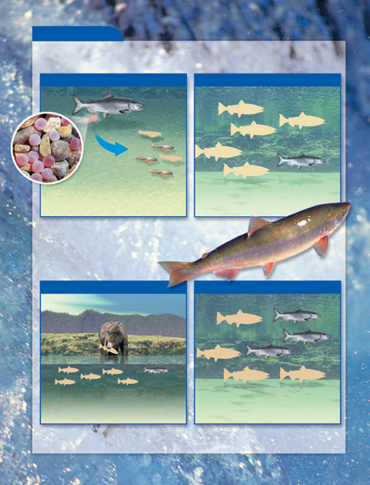
Overproduction, Variation, Adaptation, & Selection

Slide 15
The process of natural selection depends on a few key principles.
Selection is the process that passes the most successful variations, or adaptations, into the next generation.
Of the organisms that then survive to reproduce, more and more of them will have the adaptation.
The favorable traits are "selected" for the next generations. In this way, the species as a whole becomes more suited to its environment.

Slide 16
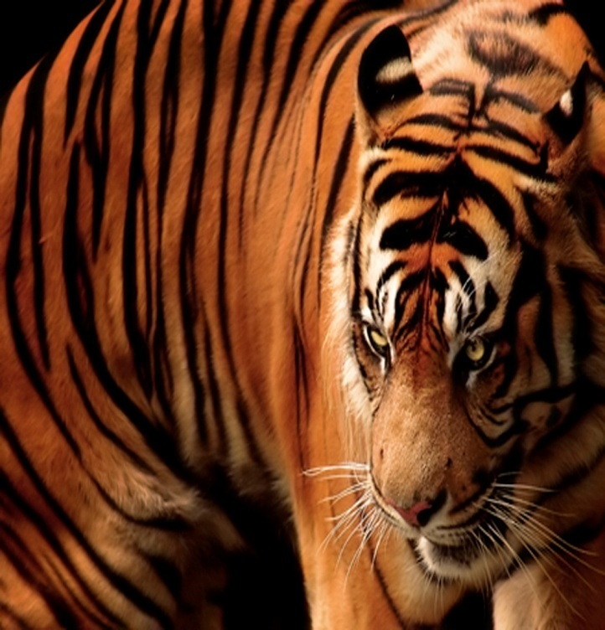
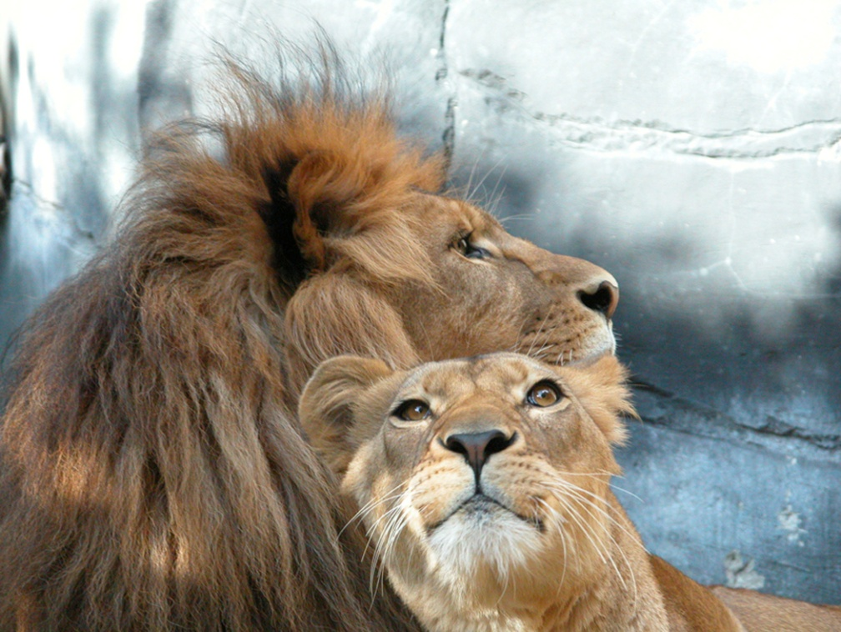
New species develop from previously existing species.
Recall that a species is a group of closely related organisms that can interbreed to produce offspring, which can also interbreed.

Slide 17
New species develop from previously existing species.
Speciation is the evolution of a new species from an existing species.
Speciation can occur when the environment changes.
When genetic changes within two groups of the same species build up, the two groups may not be able to interbreed anymore.
When this happens, two different species have formed and speciation has occurred.
The diagrams show how three species of cichlid fish evolved from one original species in Lake Tanganyika.

Slide 18
New species develop from previously existing species.
Isolation is essential to speciation.
For a species to separate, two groups must be prevented from reproducing with one another.
A geographic boundary, such as a mountain range or ocean, can result in isolation.
The cichlids in Lake Tanganyika and the finches Darwin observed in the Galapagos Islands are examples of isolation leading to new species.

