Slide 1
Senior Vocabulary
Book F Unit 8

Slide 2
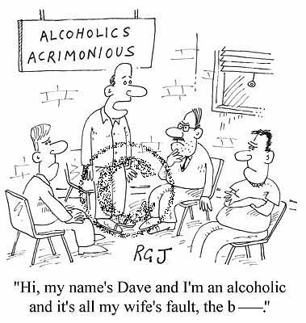
1. acrimonious—adj. stinging, bitter in temper or tone
Synonyms: Biting Caustic Hostile | Antonyms: Gentle Warm Friendly | Sentence: I was very acrimonious when I found out my boyfriend didn’t like cheese; I sprayed milk at him with a super- soaker.

Slide 3
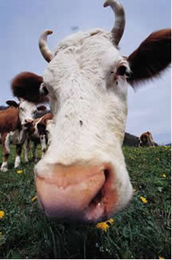
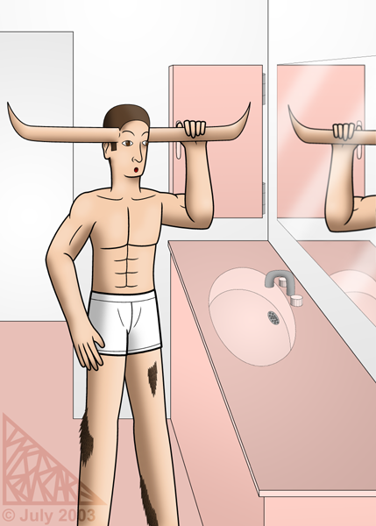
2. bovine—adj. resembling a cow or ox; sluggish, unresponsive
Synonyms: Stolid Dull Slow Stupid | Antonyms: Alert Sharp Bright Keen Quick | Sentence: Mike has a somewhat bovine expression at the moment.

Slide 4


3. consternation—n. dismay, confusion
Synonyms: Shock Amazement Bewilderment | Antonyms: Calm Composure | Sentence: The look of consternation on her face told us that she was lost.

Slide 5
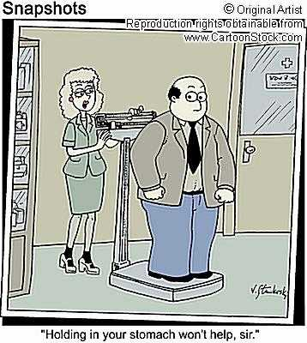
4. corpulent—adj. fat; having a large, bulky body
Synonyms: Overweight Heavy Obese Stout Portly | Antonyms: Slender Lean Spare Gaunt Emaciated | Sentence: Someone who is sixty pounds overweight can be described as corpulent.

Slide 6
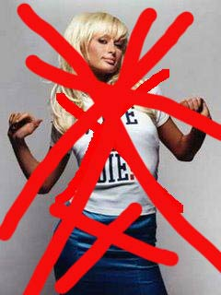
5. disavow—v. to deny responsibility for or connection with
Synonyms: Disown Disclaim Retract | Antonyms: Acknowledge Admit Grant Certify | Sentence: The kid disavowed his parents because they raised him horribly.

Slide 7
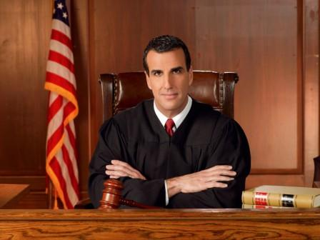
6. dispassionate—adj. impartial; calm, free from emotion
Synonyms: Unbiased Disinterested Cool Detached | Antonyms: Committed Engaged Partial Biased | Student Sentence: Judge Alex is dispassionate about his court cases, unlike Judge Judy.

Slide 8
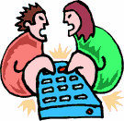
7. dissension—n. disagreement, sharp difference of opinion
Synonyms: Strife Discord Contention | Antonyms: Agreement Accord harmony | Sentence: There was much dissension about what we should watch on television.

Slide 9
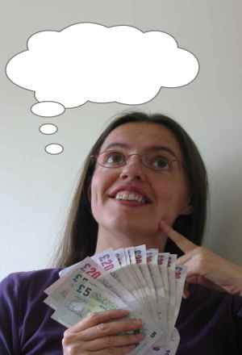
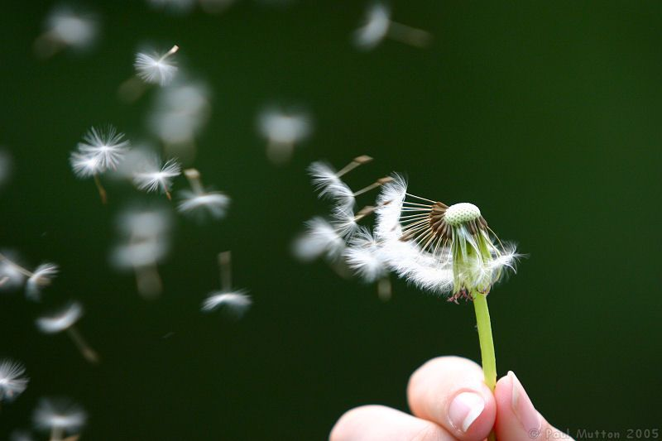
8. dissipate—v. to cause to disappear; to scatter, dispel;
to spend foolishly, squander; to be extravagant in pursuit of
pleasure
Synonyms: Disperse Strew Diffuse Waste | Antonyms: Gather Collect Conserve | Sentence: The seeds from the flower dissipated by way of the wind.

Slide 10

9. expurgate—v. to remove objectionable passages or words
from a written text; to cleanse, purify
Synonyms: Purge Censor | Antonyms: adulterate | Student Sentence: Please expurgate your letter (with all the swears in it) before you turn it in to the teacher.

Slide 11
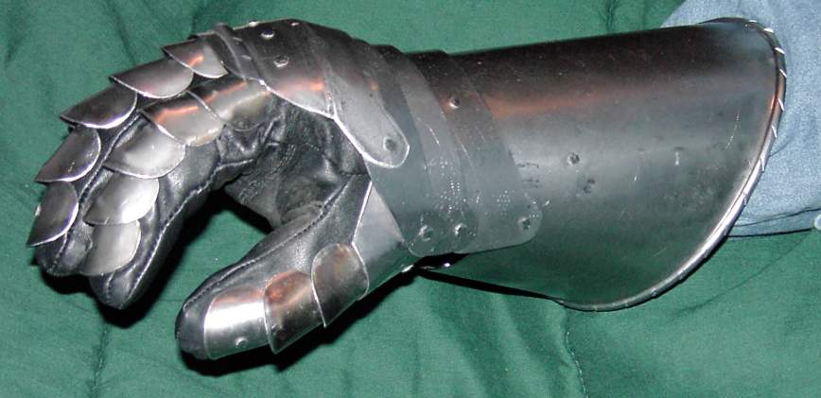
10. gauntlet—n. an armored or protective glove;
a challenge; two lines of men armed with weapons with
which to beat a person forced to run between them; an ordeal
Synonyms: Dare Trial Punishment | Antonyms: (none) | Sentence: If you pick up a gauntlet that has been thrown down, it means you have accepted a challenge.

Slide 12
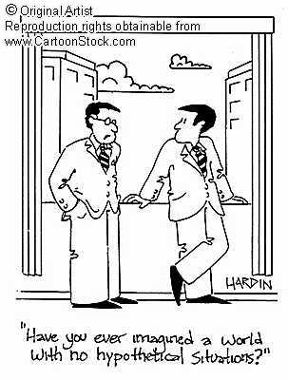
11. hypothetical—adj. based on an assumption or guess;
used as a provisional or tentative idea to guide or direct
understanding
Synonyms: Assumed Supposed | Antonyms: Actual Real Tested substantiated | Student Sentence: Science is not based on hypothetical assumptions, but on proven facts.

Slide 13

12. ignoble—adj. mean, low, base
Synonyms: Dishonorable Unworthy Inferior | Antonyms: Admirable Noble praiseworthy | Student Sentence: Most people will agree that a noble purpose does not justify ignoble means.

Slide 14
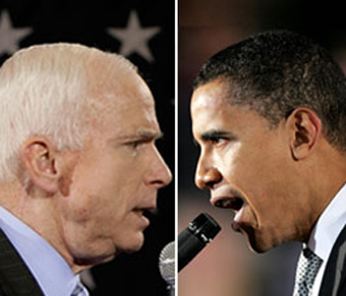
13. impugn—v. to call into question; to attack as false
Synonyms: Challenge Deny Dispute Query Question | Antonyms: Confirm Prove Verify Validate | Student Sentence: You can impugn the senator’s facts, but you cannot accuse her of concealing her intentions.

Slide 15
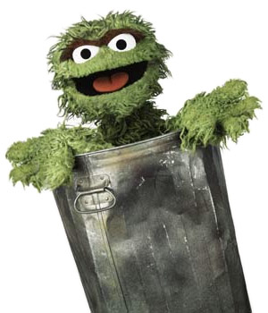
14. intemperate—adj. immoderate, lacking in self-control;
inclement
Synonyms: Excessive Extreme Unrestrained | Antonyms: Moderate Restrained | Student Sentence: Experience taught her to control her intemperate outbursts of anger.

Slide 16
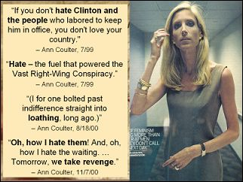
15. odium—n. hatred, contempt; disgrace or infamy resulting
from hateful conduct
Synonyms: Abhorrence Shame | Antonyms: Esteem Admiration | Student Sentence: Ann Coulter is an example of a person who has odium for practically everybody—especially Democrats.

Slide 17
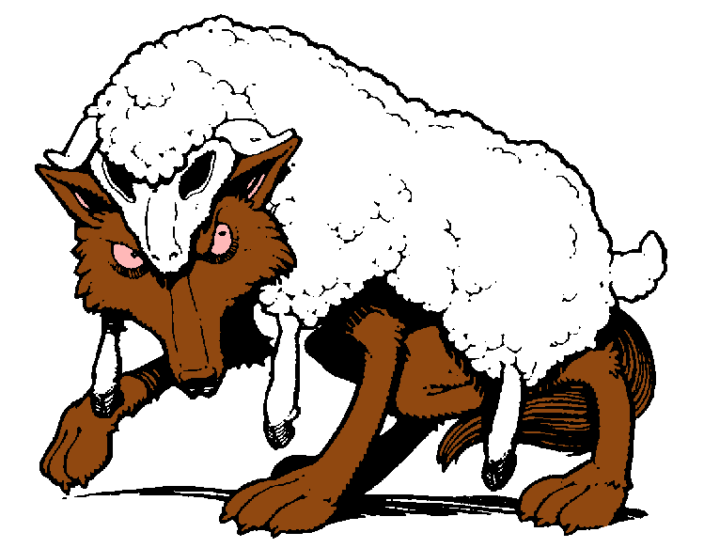
16. perfidy—n. faithlessness, treachery
Synonyms: Betrayal Disloyalty Treason Duplicity | Antonyms: Faithfulness Loyalty Steadfastness | Student Sentence: A wolf in sheep’s clothing is an example of perfidy.

Slide 18
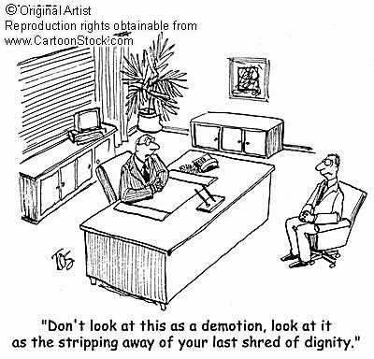
17. relegate—v. to place in a lower position; to assign, refer,
turn over; to banish
Synonyms: Transfer Consign Demote Exile | Antonyms: Promote Elevate Advance Recall | Student Sentence: If you are relegated to a less important job, you will feel sad and worthless. ☺

Slide 19
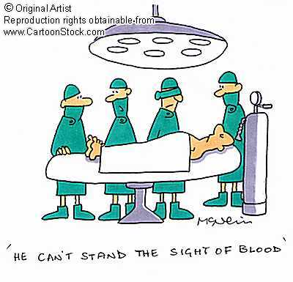
18. squeamish—adj. inclined to nausea; easily shocked or
upset; excessively fastidious or refined
Synonyms: Nauseated Queasy Delicate Oversensitive | Antonyms: (none) | Student Sentence: is squeamish today because he dissected a frog in biology.

Slide 20

19. subservient—adj. subordinate in capacity or role;
submissively obedient
Synonyms: Secondary Servile | Antonyms: Primary Bossy Domineering | Student Sentence: Someone who is subservient is likely to take orders from other people without making a fuss about it.

Slide 21
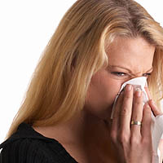
20. susceptible—adj. open to; easily influenced;
lacking in resistance
Synonyms: Vulnerable Receptive impressionable | Antonyms: Resistant Immune | Student Sentence: You will be more susceptible to a cold if you have a weak immune system.

