Slide 1
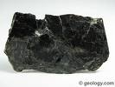
Biotite
Mohs 2.5
Cleavage 1 directional
Fracture uneven
Color Black/Brown
Looks Like candy uneaten
Can be bent
Igneous

Slide 2
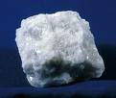
Marble
Mohs 4-5
Metamorphic
Color many different
Shiny crystallized limestone

Slide 3

Copper
Mohns 2,5/3.0
Mineral
Fracture Jagged
Color Brown
Reacts
Streak rose

Slide 4
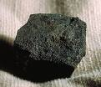
Bituminous Coal
Metamorphic
Color Black

Slide 5
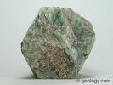
Apatite
Mineral many different colors
Mohs 5

Slide 6
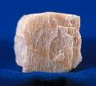
Feldspar
Mohs 6
Cleavage 2 plains flat
Fracture brittle
Color Milky white
Somewhat pink
Nonreact
Coarse Grain
Streak White

Slide 7


Talus Slope
An accumulation of broken rock that lies on a steep mountainside or at the base of a cliff

Slide 8
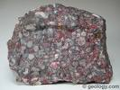
Conglomerate
Mohs 3
Sedimentary
Color Gray
Bound together with cement
Reconsolidated gravel

Slide 9

Basalt
Mohs 2
Igneous
Dark/Black
Fine grained sponge like
Volcanic

Slide 10

Fluorite
Mohs 6
Mineral
Cleavage perfect
Fracture uneven
Color many different
Nonreact
Streak white

Slide 11
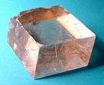
Calcite
Mohs 3
Cleavage 3 directional smooth
Color Clear/white
Reacts
Streak white

Slide 12
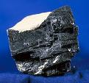
Galena
Mohs 2
Cleavage easy cubic
Nonreact
Very heavy
Streak white
Mineral

Slide 13
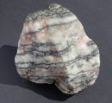
Gneiss
Mohs 6
Metamorphic
Color Gray Pink
Looks like layered Cake
nonreact

Slide 14

Granite
Mohs 6
Color Gray White Pink
Igneous
Course grain

Slide 15
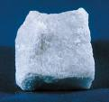
Gypsum
Mohs 2
Mineral
Cleavage 2 plains 1 perfect
Color Colorless/white
Nonreact
Streak White

Slide 16
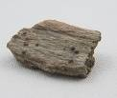
Garnet Schist
Metamorphic

Slide 17

Kaolinite
Mohs 2-2.5
Mineral
Cleavage none
Fracture uneven
Color White
Many layers bumpy powder
nonreact

Slide 18
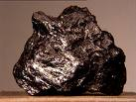
Graphite
Mohs 1-2
Mineral
Cleavage 1 Directional
Fracture uneven
Color Black silvery
Used in pencils

Slide 19

Limestone
Mohs 4
Sedimentary
White gray yellow
Fossils/shells
Reacts

Slide 20

Hematite
Mohs 5-6
Mineral
Cleavage None
Fracture uneven
Color steel/ gray
Nonreact
Magnetic
Streak reddish/brown

Slide 21
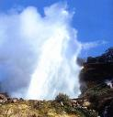
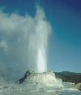
Geyser
Part of the water bursts into steam, and the change in pressure causes other parts
Of the network to do the same

Slide 22
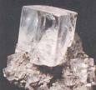
Halite
Mohs 2-2.5
Mineral
Cleavage 3 Directional
Fracture uneven
Color clear/white
Cube shaped
Nonreact
Streak white

Slide 23

Mica
Mohs 2.5-3.0
Mineral
Cleavage perfect
Fracture even
Color Brown
No bumps
Shiny

Slide 24
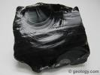
Obsidian
Mohs 5.5
Igneous
Cleavage none
Fracture jagged
Dark /Black
Glass Like

Slide 25
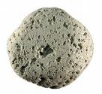
Pumice
Mohs 6
Igneous
Color Tan/Brown
Light weight many holes
Floats on water

Slide 26


Pyrite
Mohs 6-6.5
Mineral
Fracture cubed
Color Gold/Silver

Slide 27
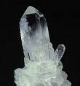
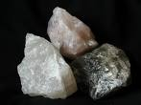
Quartz
Mohs 7
Mineral
Color Milky
Etched faces
Crystals
Streak White

Slide 28
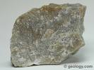
Quartzite
Mohs 7
Metamorphic
Feels like grinds of sand

Slide 29

Red Sandstone
Feels like grinds of sand
Color Red

Slide 30
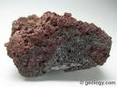
Scoria
Igneous
Color Dark
Light Spongy
Large Air Holes

Slide 31
Geyser
Part of the water bursts into steam, and the change in pressure causes other parts
Of the network to do the same

Slide 32


Shale
Mohs 3
Sedimentary
Color Many
Flat soft

Slide 33
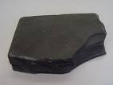
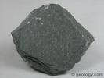
Slate
Mohs 2-2.5
Metamorphic
Flat
Color Gray
One layer
Building Material

Slide 34
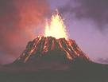

Volcanoes
Place where lava – hot melted rock comes out of the ground and builds a pile

Slide 35

Anticline
Fold structure in which the sides of the slope apart

Slide 36
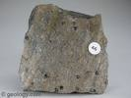
Schist
Mohs 4-5
Metamorphic
Color white/gray
Chunky Tiny crystals

Slide 37


Tectonic
A large-scale structure

Slide 38
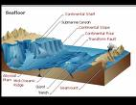
Plates
Fossil evidence suggests that continents where once connected that are far apart
Today; plate movements are responsilble http://www.ucmp.berkeley.edu/geology/tecall1_4.avi

Slide 39
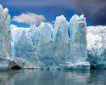

Glaciers
Typically ice, but can be rock (the ice is hidden)

Slide 40
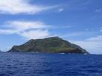

Island
Any piece of land completely surrounded by water

Slide 41
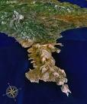
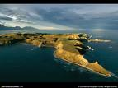
Peninsula
A piece of land that projects into a body of water and is connected with
the mainland by an isthmus.

Slide 42


Plains
Plains are flat areas or low relief areas on the earth’s surface, e.g. prairies, steppes.
Plains are formed due to the sedimentation of the eroded soil from the hills
and mountains or due to the flowing lava deposited by the agents of wind, water and ice.

Slide 43
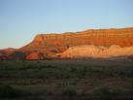

Plateaus
Plateaus are large highland flat areas separated from the surrounding areas by a steep slope, e.g.
The Tibetan plateau.
Plateaus are formed due to various actions such as collision of the
earth’s tectonic plates, uplift of the
earth’s crust by the action of magma; some are resulted due to the lava flow
from the volcanic eruption.

Slide 44

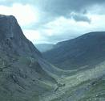
Valleys
Valleys are flat areas of land between the hills or mountains, e.g. The California Central Valley. Mostly they are formed by the actions of rivers and glaciers. Depending upon the shape, valley forms are classified as U-shaped or V-shaped valley. V-shaped valleys are formed by flowing water or rivers, whereas U-shaped valleys are formed by glaciers.

Slide 45

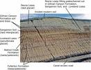
Loess
Loess are deposits of silt and with a little amount of sand and clay.
Many a times wind action is responsible for
formation of loess; however sometimes glacial activity can also form loess.

Slide 46
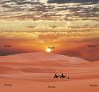

Deserts
Deserts are very dry lands with little or no rainfall, for example, The Sahara desert. Mostly deserts are formed in rainshadow areas, which are leeward of a mountain range with respect to the wind direction. Thus, the mountains block the passage of wind resulting in little or sometimes no rain.

Slide 47


Canyon
is a deep ravine between cliffs often carved from the landscape by a river.

