Slide 1
Ophiocordyceps
The Zombie Fungus

Slide 2
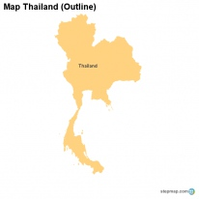
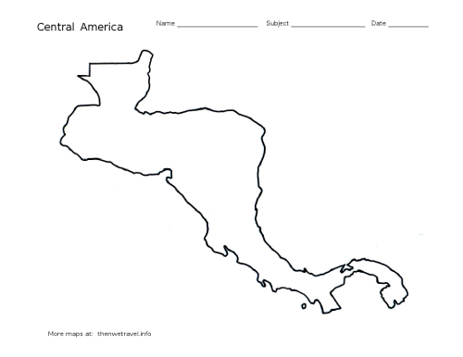
Where it can be found?
Ophiocordyceps grows in warm temperature forest in Central America , Africa ,Brazil , Thailand and grow in warm tropical forest.

Slide 3
What does it do?
Ophiocordyceps takes over a campontina ant’s brain by attaching to the ants head and gains control of the body like a zombie. It forces the ant to go to lower ground and finds a leaf to bite on and forcefully kills the ant and grows from there. Then eats the rest of the inside of the ant.

Slide 4
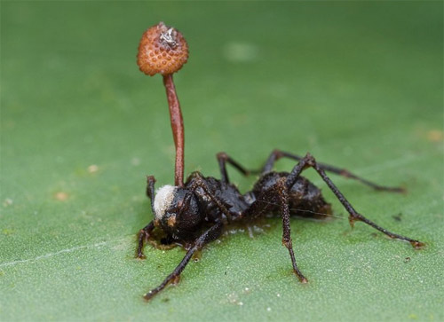
Its too late!
Once Ophiocordyceps infects the species it is to late to kill the virus.

Slide 5
The Facts
Ophiocordyceps is an entomopathogenic fungus .Entomopathogenic fungus is a fungus that can act as a parasite of insects and kills or disables them.

Slide 6
Did you know?
Like video games? Ophiocordyceps inspired the game the last of us.

Slide 7
Made by…
Created by Aaron and Nicole the most awsome people in class!!
Bat Nicole and Super Aaron

Slide 8
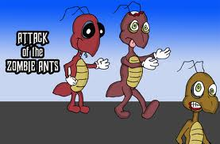
Want to learn more? Check out this video

