Slide 1
Introductory
Chapter
Section 2 Scientific Methods
Bellringer
Write a brief response to this question: “Which is more important, imagination or knowledge?”
Write your response in your science journal.

Slide 2
Introductory
Chapter
Section 2 Scientific Methods
Objectives
Describe scientific methods.
Determine the appropriate design of a controlled experiment.
Use information in tables and graphs to analyze experimental results.
Explain how scientific knowledge can change.

Slide 3
Introductory
Chapter
Section 2 Scientific Methods
What Are Scientific Methods?
Scientific methods are the ways in which scientists answer questions and solve problems.

Slide 4
Introductory
Chapter
Section 2 Scientific Methods
Ask a Question
Asking a question helps focus the purpose of the investigation. Scientists often ask a question after making an observation.
For example, students observing deformed frogs might ask, “Could something in the water be causing the deformities?”

Slide 5
Introductory
Chapter
Section 2 Scientific Methods
Make Observations
Accurate Observations Any information that you gather through your senses is an observation. Scientist use standard tools and methods to make and record observations.

Slide 6
Introductory
Chapter
Section 2 Scientific Methods
Form a Hypothesis
A hypothesis is a possible explanation or answer to a question that is based on observation and can be tested.
A statement of cause and effect that can be used to set up a test for a hypothesis is called a prediction.

Slide 7
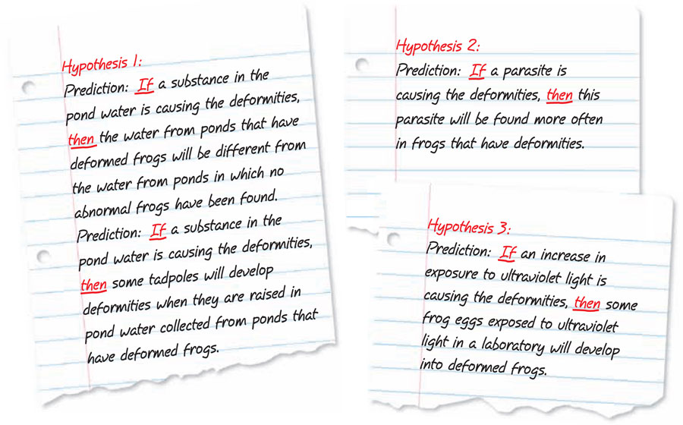
Introductory
Chapter
Section 2 Scientific Methods
A Hypothesis Makes Predictions

Slide 8
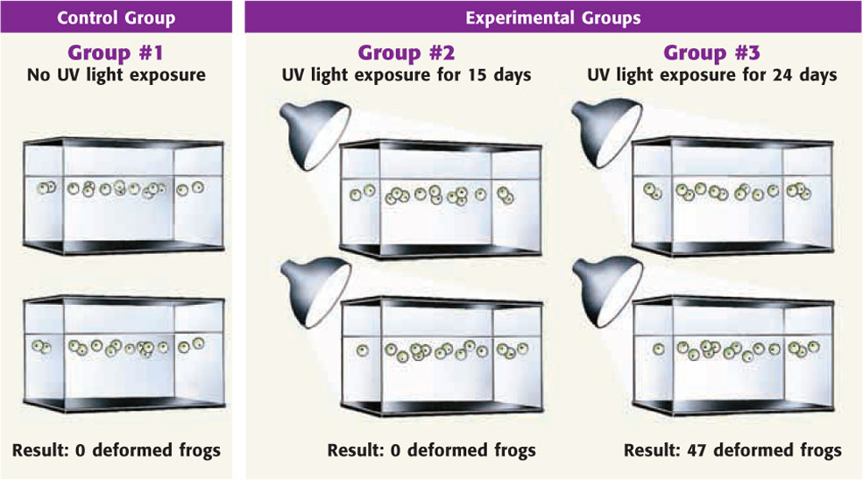
Introductory
Chapter
Section 2 Scientific Methods
Test the Hypothesis
Under Control A controlled experiment tests only one factor at a time and consists of a control group and one or more experimental groups.

Slide 9
Introductory
Chapter
Section 2 Scientific Methods
Test the Hypothesis, continued
Designing an Experiment Designing a good experiment requires planning and a consideration of all factors.
Collecting Data Scientists keep clear, accurate, honest records of their data so that other scientists can repeat the experiment and verify the results.

Slide 10
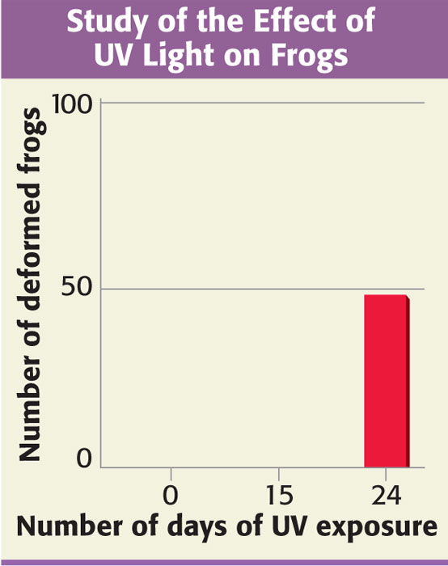
Introductory
Chapter
Section 2 Scientific Methods
Analyze the Results
After they finish their tests, scientists must analyze the results. Analyzing the results helps scientists explain and focus on the effect of the variable.

Slide 11
Introductory
Chapter
Section 2 Scientific Methods
Draw Conclusions
Scientists must conclude if the results of their tests support the hypothesis. Proving that a hypothesis is not true can be as valuable as proving that it is true.

Slide 12
Introductory
Chapter
Section 2 Scientific Methods
Communicate Results
After finishing an investigation, scientists communicate their results.
Sharing allows other scientists to repeat experiments to see if they get the same results.
Sometimes, new data lead scientists to change their hypotheses.

Slide 13
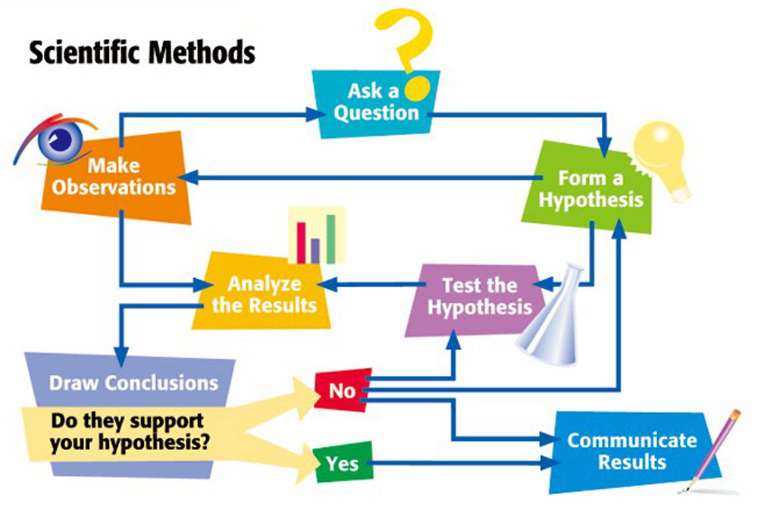
Introductory
Chapter
Section 2 Scientific Methods

Slide 14
Introductory
Chapter
Section 3 Scientific Models
Bellringer
Answer the following questions in your Science Journal:
What is a model?
Name several types of models.
What models have you used?

