Slide 1
The Traveler
Your New Hall Pass

Slide 2
Why have we made a change?
The purpose of the Traveler is to have students take responsibility for the mechanics associated with traveling from place to place in the building.
Using this system teachers will be able to keep students safe and students will be accountable for time spent out of the classroom.

Slide 3
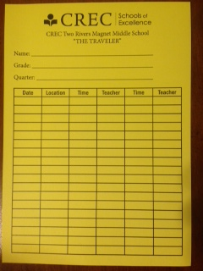
The Traveler
Each student will be issued a yellow Traveler pass at the beginning of the marking period.
At the end of the marking period, homeroom teachers will collect them.
Students must write their names in INK on both sides of the pass.
Students must carry the pass with them at all times.

Slide 4
Student Responsibilities
Students are responsible for filling in the date, time, and place on the Traveler. The teacher will initial the Traveler. Students may not leave the room without a signed Traveler.
Paper Passes/agenda are not allowed to be used. If student does not have the Traveler, the teacher will issue a restricted traveler for the day.
If the Traveler is lost or stolen, students may obtain a second pass by paying a $1.00 fee. A record will be kept by Team Leaders of those students issued more than one Traveler.

Slide 5
Restricted Red Traveler
A student who loses two Travelers will be placed on red restricted pass. Red restricted passes are in place for two weeks.
Restricted Traveler passes limit a student to two trips out of the room per day for a week and four trips out of the room for the second week.

Slide 6
Limits on the pass
Students are not to “lend” their Traveler pass to other students.
Abuse of the Traveler will result in a red restricted pass.
Teachers will write passes at their discretion.

Slide 7

Reporting to Administration
Students who are asked to report to administration should report immediately. The Traveler pass is not required.

Slide 8
Special Notes
When all available spaces on the Traveler are filled, a student may obtain a new Traveler from the Team Leader by turning in the used Traveler. These students will not have to pay for a new one.
Gold Cards will replace Travelers
  Deserving students will be issued Gold Cards during the Honors Assembly at the end of November. Students who earn a Gold Card will not have to use the Traveler Pass.

